Slide 1
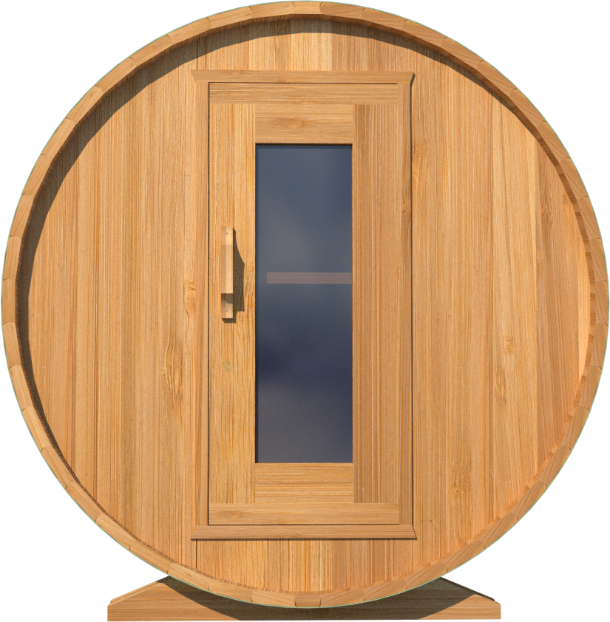
09/2022
670C/672C
6’x7’ (214cm) Barrel Sauna with Changeroom
72”
183 cm
53”
134 cm
72”
183 cm
38 ½”
98 cm
10”
25 cm
22 ¾”
58 cm
2”
5cm
48”
122 cm
tel: 888-923-9813 | info@leisurecraft.com| web: www.leisurecraft.com

Slide 2
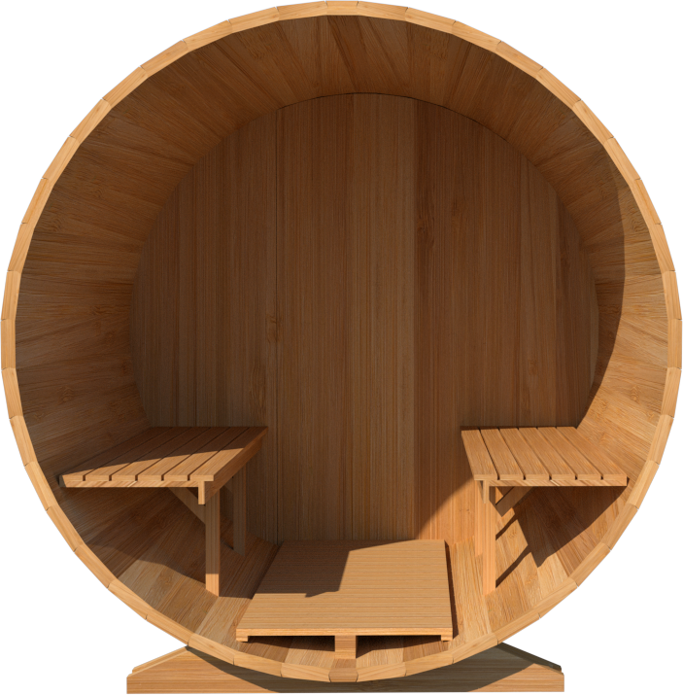
670C/672C
6’x7’ (214cm) Barrel Sauna with Changeroom
69 ¼”
176 cm
69 ¼”
176 cm
20”
51 cm
3 ¼”
8 cm
17 ½”
45 cm
23 ½”
60 cm
17 ½”
45 cm
26 ¾”
68 cm
Standard bench layout shown with optional sauna floor
(product # 402003)
tel: 888-923-9813 | info@leisurecraft.com| web: www.leisurecraft.com
tel: 888-923-9813 | info@leisurecraft.com| web: www.leisurecraft.com

Slide 3
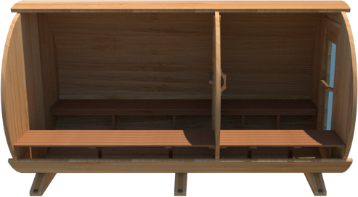
670C/672C
6’x7’ (214cm) Barrel Sauna with Changeroom
131”
333 cm
75 ½”
192 cm
46 ½”
118 cm
53”
135 cm
53”
135 cm
5 ½”
14 cm
5 ½”
14 cm
tel: 888-923-9813 | info@leisurecraft.com| web: www.leisurecraft.com
tel: 888-923-9813 | info@leisurecraft.com| web: www.leisurecraft.com

Slide 4
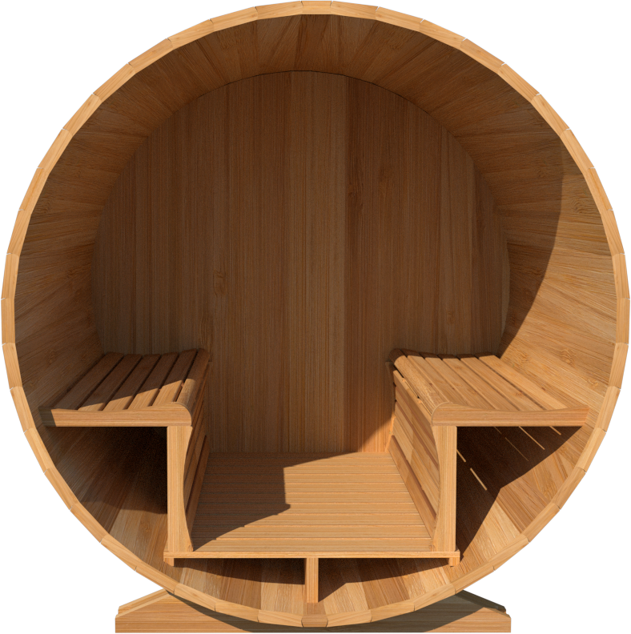
670C/672C
6’x7’ (214cm) Barrel Sauna with Changeroom
67SSU
Signature Sauna Benches 6’x7’ Barrel
62 ¾”
159 cm
18”
46 cm
24 ½”
62 cm
6 ¼”
16 cm
18 ¼”
46 cm
28 ¾”
73 cm
18 ¼”
46 cm
35 ½”
90 cm
tel: 888-923-9813 | info@leisurecraft.com| web: www.leisurecraft.com
tel: 888-923-9813 | info@leisurecraft.com| web: www.leisurecraft.com

Slide 5
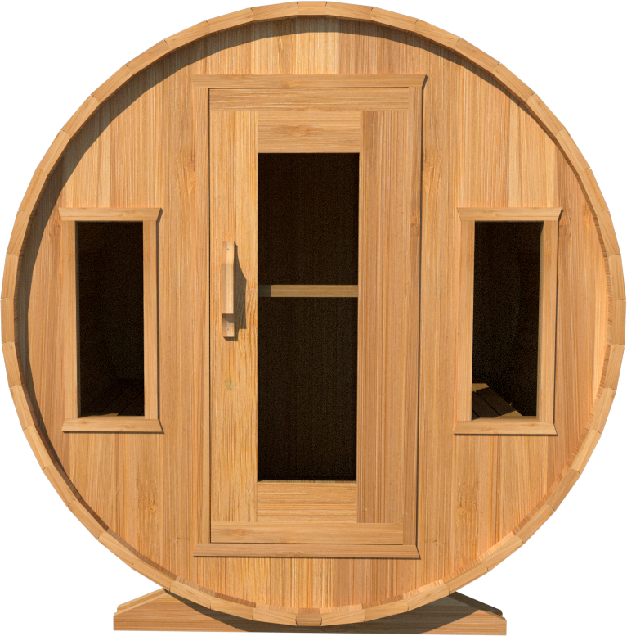
670C/672C
6’x7’ (214cm) Barrel Sauna with Changeroom
W2
2 Windows in Front Wall
12”
30 cm
26 ¼”
67 cm
51 ½”
131 cm
25 ¼”
64 cm
4 ¾”
12 cm
*Product W2 - 2 windows available on changeroom or back wall at same measurements as front wall
tel: 888-923-9813 | info@leisurecraft.com| web: www.leisurecraft.com

Slide 6
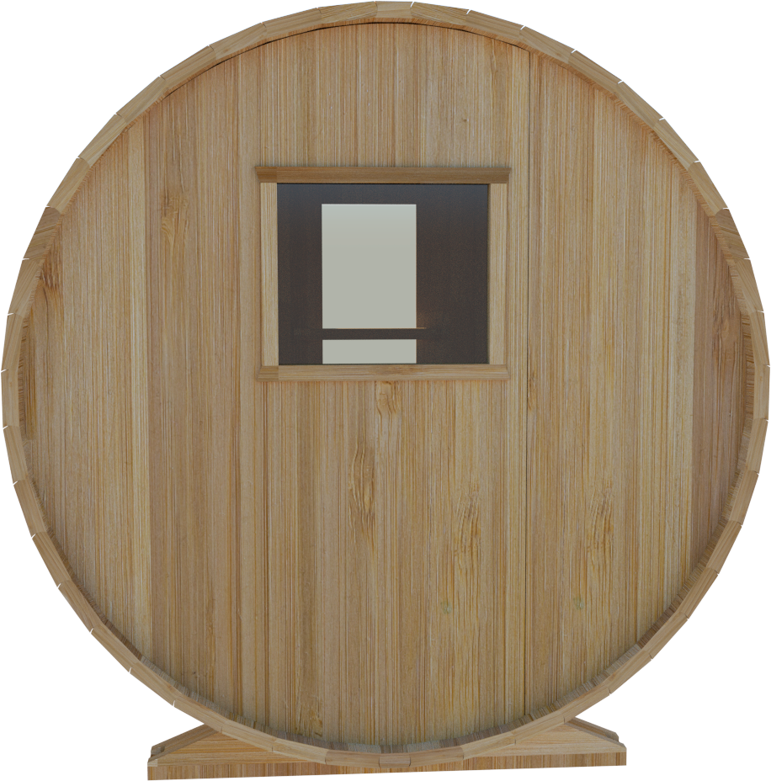
670C/672C
6’x7’ (214cm) Barrel Sauna with Changeroom
W1
Rectangle Window in Back Wall
24”
61 cm
20”
51 cm
39 ¾”
101 cm
tel: 888-923-9813 | info@leisurecraft.com| web: www.leisurecraft.com

Slide 7
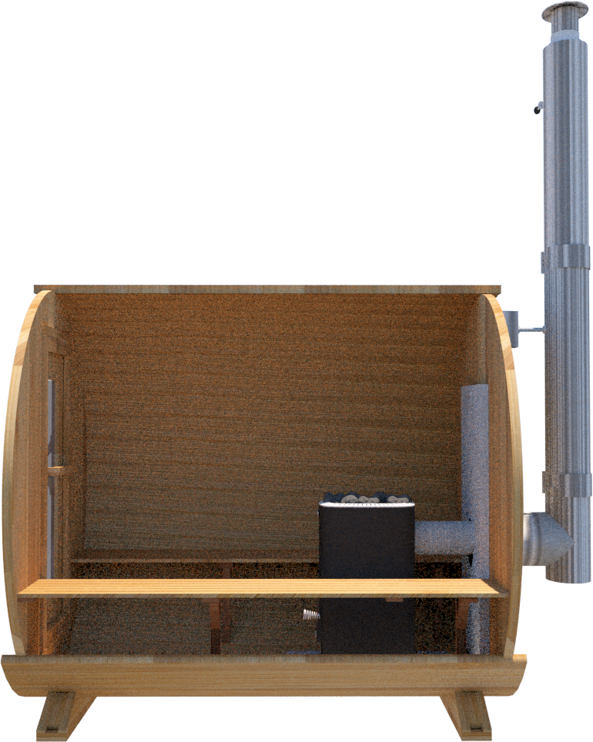
670C/672C
6’x7’ (214cm) Barrel Sauna with Changeroom
Wood Burning Heater
Please note – Drawing shows sauna room measurements only.
116”
295 cm
123 ½”
314 cm
28”
71 cm
46 ½”
118cm
17”
43cm
12”
30cm
tel: 888-923-9813 | info@leisurecraft.com| web: www.leisurecraft.com

